Slide 1


Advanced Gluttonous Snake PrEsentation2
Slytherin
Shanshan zhao
Liyi cao
Yujia wang
Yinzhu Su
http://tech.sina.com.cn/roll/2017-07-21/doc-ifyihrwk1647246.shtml

Slide 2

Goal of our project
We are trying to build a video game based on FPGA and Verilog.
The game is similar with Gluttonous Snake.
Easy to control. Low hardware requirement. Only need few external devices.
ADVANCED Gluttonous Snake.
https://cn.technode.com/post/2017-10-13/razer-phoneleak-8gb-ram/

Slide 3
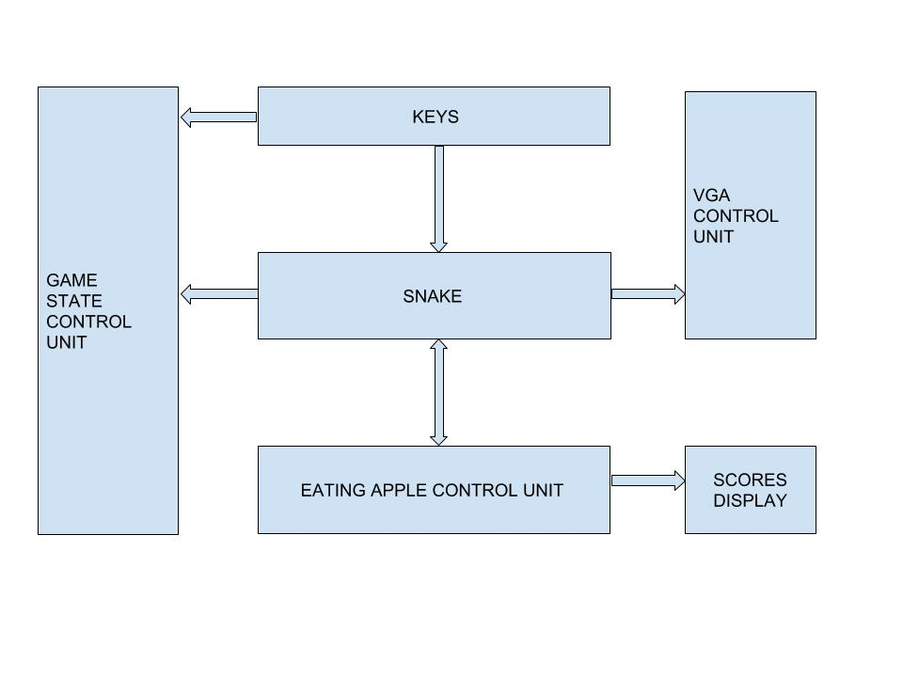
Block diagram of our project
https://cn.technode.com/post/2017-10-13/razer-phoneleak-8gb-ram/
https://cn.technode.com/post/2017-10-13/razer-phoneleak-8gb-ram/

Slide 4
What is done and how we tested it (i.e. what is working now)
Snake’s movement
Direction control
Random apple position
Snake’s growing
Score record
https://cn.technode.com/post/2017-10-13/razer-phoneleak-8gb-ram/
https://cn.technode.com/post/2017-10-13/razer-phoneleak-8gb-ram/

Slide 5
What are you working on currently and the status (i.e. what is in progress)
Solving the current bugs.
When the snake bite itself, GAME OVER.
Beautifying the whole game view.
https://cn.technode.com/post/2017-10-13/razer-phoneleak-8gb-ram/
https://cn.technode.com/post/2017-10-13/razer-phoneleak-8gb-ram/

Slide 6
What do need to do and when you plan begin (i.e. what is not started)
Adding different groups of blocks to make the game harder.
Adding more function apples.
Adding another snake.
https://cn.technode.com/post/2017-10-13/razer-phoneleak-8gb-ram/
https://cn.technode.com/post/2017-10-13/razer-phoneleak-8gb-ram/

Slide 7
Things that are going well.
We can control the snake’s moving direction by buttons.
The game can randomly produce an apple on the screen.
When the snake eats the apple, the snake-length and the score shown on the 7-segment-display grow together.
https://cn.technode.com/post/2017-10-13/razer-phoneleak-8gb-ram/
https://cn.technode.com/post/2017-10-13/razer-phoneleak-8gb-ram/

Slide 8
Things that are not going so well
The score is ascending but not homogeneous.
The score is not growing by one.
0 → 2 → 4 → 6 → 8 → 9 → 10 → 12 → 14 → 16 → … …
It’s too complex to beautify the game view.
We don’t know how to produce infinity-length-snake yet.
https://cn.technode.com/post/2017-10-13/razer-phoneleak-8gb-ram/

Slide 9
Timeline and project assignments
2.15 Presentation 1
2.16-3.15 Building basic game frame
3.16-3.24 VGA displaying via FPGA
3.24-3.26 Testing basic game frame
3.27 Presentation 2
3.28-4.2 Add fail view of the game
4.3-4.6 Add blocks
4.7-4.14 Add more functional apples
4.15-4.23 Add battle system
4.24-4.25 Presentation 3
4.26-4.30 Testing the whole game
5.1 Project Demo
https://cn.technode.com/post/2017-10-13/razer-phoneleak-8gb-ram/

Slide 10
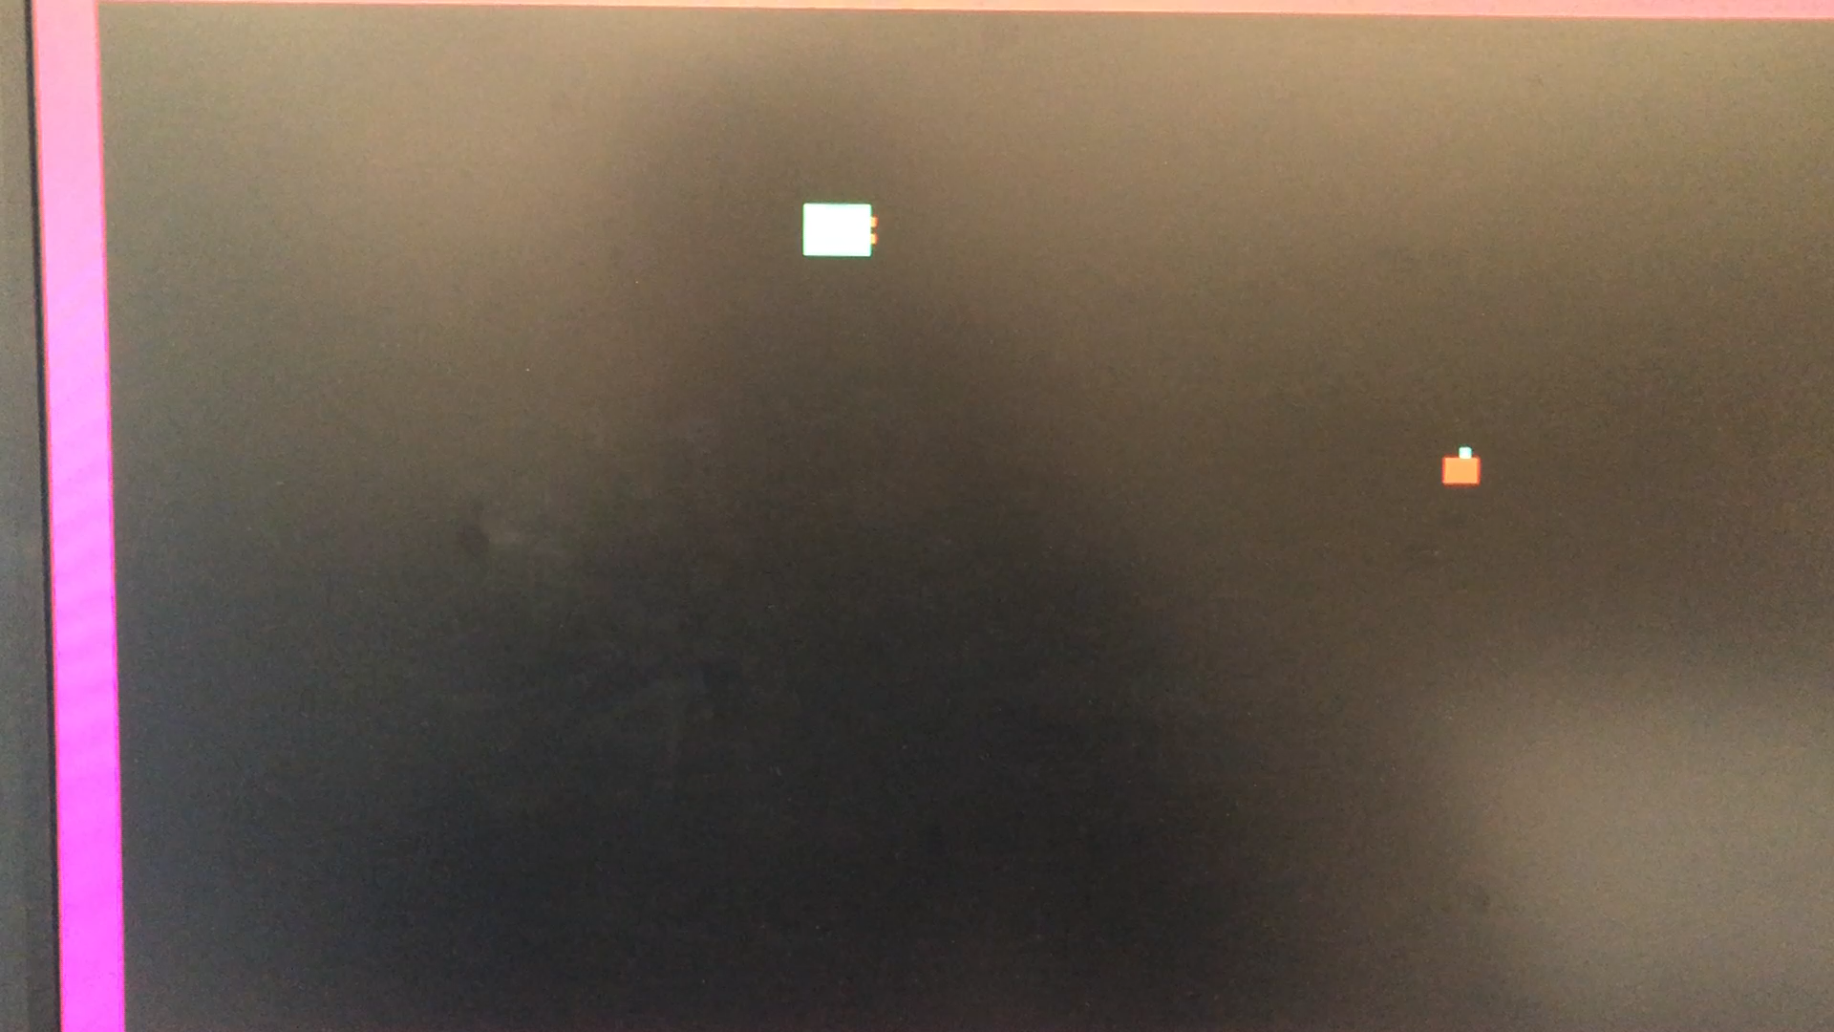
Demo
https://cn.technode.com/post/2017-10-13/razer-phoneleak-8gb-ram/

Slide 11
Thank You！
https://cn.technode.com/post/2017-10-13/razer-phoneleak-8gb-ram/

